Slide 1
Scientific journals and articles:
So much to read; so little time.
So, what are we looking for?
Today:
The process of publishing science
Scientific journals
The art of the title

Slide 2
How is science published?
Choose a journal to submit your manuscript
Often you write the draft of the manuscript with this journal in mind far in advance
Each journal has specific formatting requirements you must follow
Submit the manuscript online
An editor sends the manuscript out to 2-4 anonymous peer reviewers
Who are peer reviewers and how are they chosen?
Reviews come back and the editor makes a decision
Usually five options: Accept-as-is, Minor revisions, Major revisions, Reject + resubmit, or Reject without option to resubmit
Manuscript is accepted to the journal!
Journal staff type-set the article and it is published (usually a month or more after acceptance)

Slide 3
The Scientific Method (see week 1 ppts)
The Question
The Study
The Manuscript
REJECT
Response FROM Editor
External Review
Submit to Journal
ACCEPT
RESUBMIT
Response TO Editor
Manuscript
Accepted
Manuscript
Published

Slide 4
The Scientific Method (see week 1 ppts)
3 – 12 months (years if multiple journals)
The Question
The Study
The Manuscript
REJECT
Response FROM Editor
External Review
Submit to Journal
ACCEPT
RESUBMIT
Response TO Editor
Manuscript
Accepted
Manuscript
Published

Slide 5
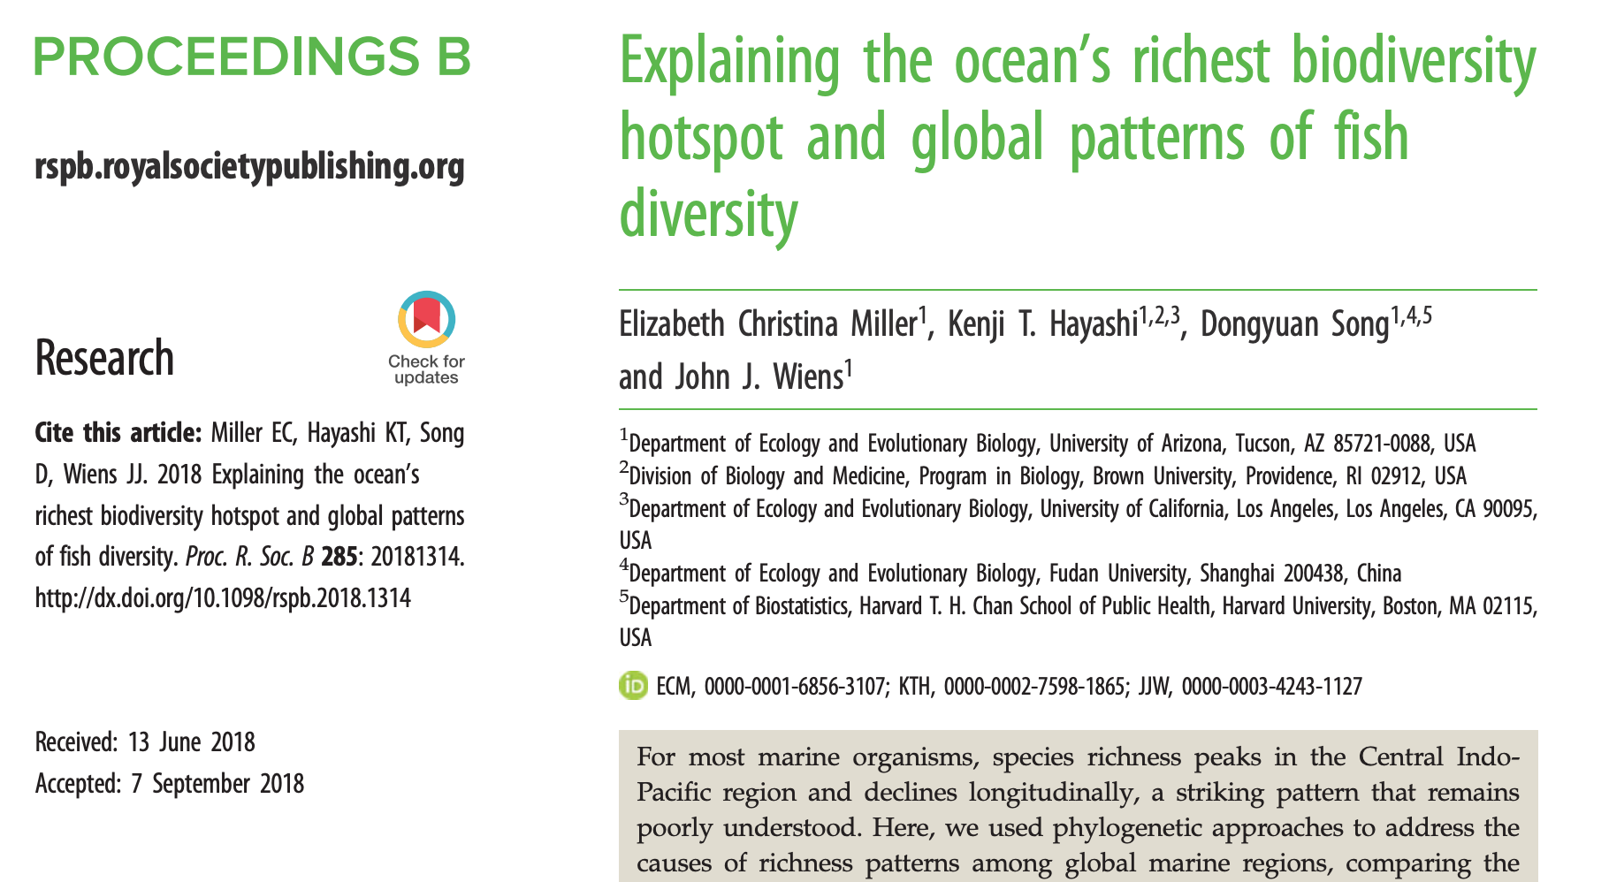
How is science published?
An example from my post-doc’s experience:

Slide 6
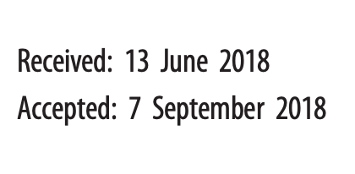
How is science published?
An example from my post-doc’s experience:

Slide 7
How is science published?
An example from my post-doc’s experience:
Lessons:
Publishing takes a long time
Rejection is the NORM!
(cue 5 stages of grief)
Behind the scenes, it took 1 year from final draft to published paper
October 2017: finished the “final” draft, submit PNAS
November 2017: PNAS reject, reformat + submit PLoS Biology.
2 days later PLoS Biol reject, reformat + submit to Proc. B
March 2018: Decision: Reject + resubmit
June 2018: revisions done, sent back to Proc B
August 2018: Decision: Minor revisions
September 2018: revisions done, sent back to Proc B
September 2018: Accept as-is
October 2018: Paper comes out in journal

Slide 8
How is science published?
An example from my experience:
“Final draft” submitted to Systematic Biology – summer 2014
3 rejections in 3 different journals
2 additional rounds of revision in Molecular Phylogenetics and Evolution
Finally published in 2018

Slide 9
How is science published?
An example from my experience:
“Final draft” submitted to Systematic Biology – summer 2014
3 rejections in 3 different journals
2 additional rounds of revision in Molecular Phylogenetics and Evolution
Finally published in 2018

Slide 10
The Scientific Method (see week 1 ppts)
The Question
The Study
The Manuscript
REJECT
Response FROM Editor
External Review
Submit to Journal
ACCEPT
RESUBMIT
Response TO Editor
Manuscript
Accepted
Manuscript
Published

Slide 11
Class activity 1:
We will look at the names of selected journals and you will indicate whether you would regard them as
likely to read
might read if I had time
not likely to read
Remember, we are all busy and no one can read everything. There are 12 journals, so you must choose 4 to read, 4 “maybes” and 4 that you’d skip.

Slide 12
Would you read this journal:
Journal title Yes Maybe Not Likely
Marine Biology
Freshwater Biology
Animal Behaviour
Ecological Modeling
Ecology
Molecular Ecology
Journal of Fish Biology
Journal of Crustacean Biology
Journal of Fish Diseases
Science
Canadian Journal of Zoology
Canadian Journal of Fisheries
and Aquatic Sciences

Slide 13
Journals in which SAFS faculty published in 2002–2012
2002-2012 |  | 2013-2023
Canadian Journal of Fisheries and Aquatic Sciences | 85 | Fish Res | 121
Transactions of the American Fisheries Society | 56 | ICES J Mar Sci | 113
Fisheries Research | 38 | Can J Fish Aquat Sci | 100
ICES Journal of Marine Science | 32 | PLOS ONE | 76
Marine Ecology Progress Series | 31 | Fish and Fisheries | 68
Ecology | 23 | Mar Ecol Prog Ser | 65
Journal of Cetacean Research and Management | 23 | Trans Am Fish Soc | 49
Copeia | 21 | Proc Nat Acad Sci | 46
Ecological Applications | 19 | Ecol Appl | 36
Fish and Fisheries | 19 | Ecol Evol | 36
Journal of Fish Biology | 19 | Front. Mar. Sci. | 34
North Pacific Anadromous Fish Commission Bulletin | 19 | Ecology | 31
Fisheries Oceanography | 18 | Ecosphere | 31
Fisheries | 18 | Deep-Sea Res Part II | 28
Proceedings of the National Academy of Sciences | 18 | Mol Ecol | 27
Fishery Bulletin | 17 | Glob Change Biol | 26
Marine and Freshwater Research | 17 | N Am J Fish Mgmt | 25
North American Journal of Fisheries Management | 15 | J Appl Ecol | 24
Conservation Biology | 14 | Mar Policy | 24
Freshwater Biology | 14 | Sci Rep | 24
Ecosystems | 13 | Environ Biol Fish | 23
Limnology and Oceanography | 13 | Science | 23
Ecological Modeling | 12 | Ecol Model | 22
Science | 12 | Proc R Soc Lond B | 22

Slide 14
The art of the title
Or, you never get a second chance to make a first impression.

Slide 15
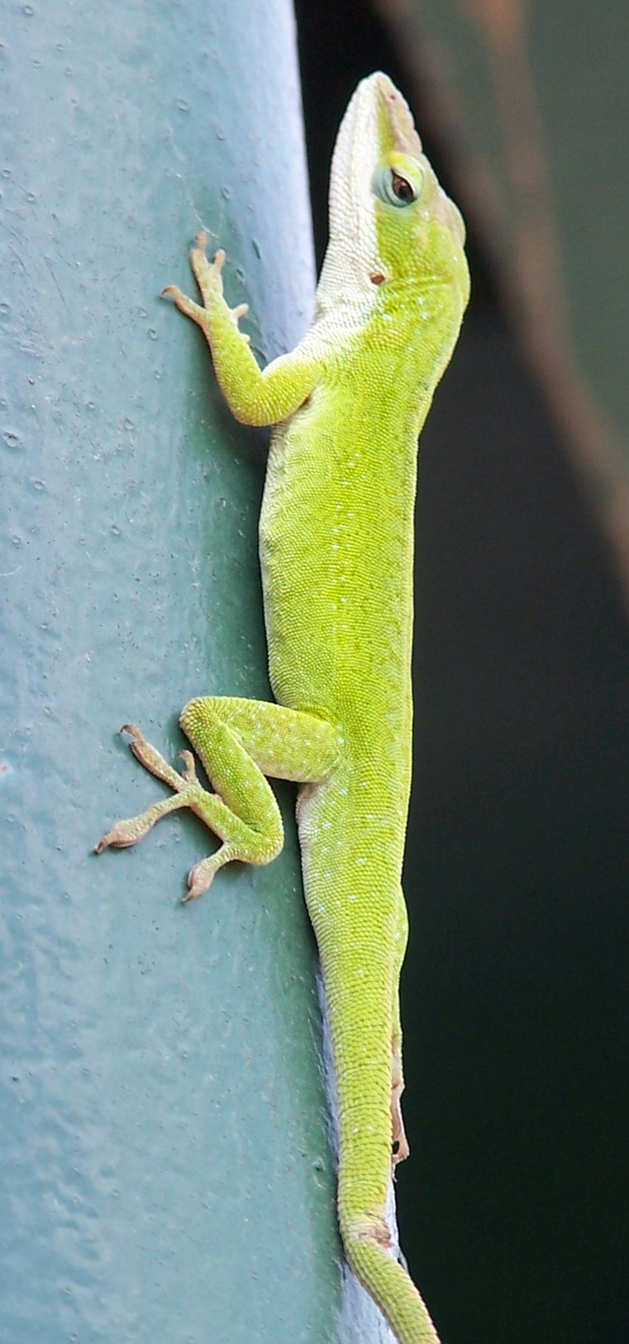
The art of the title
Imagine you do a study on anole biogeography. What is your title going to be?

Slide 16
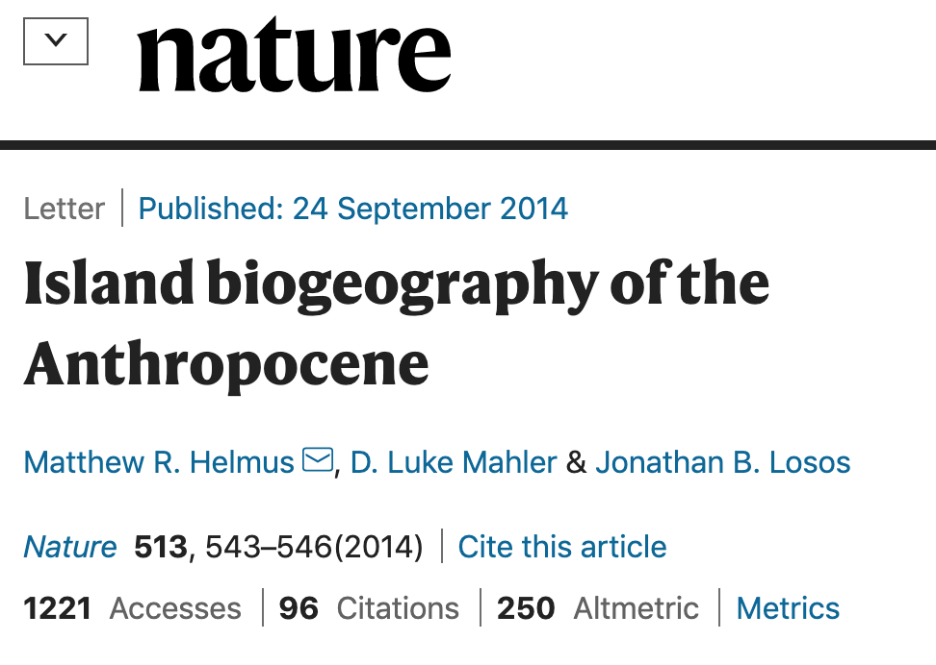
The art of the title
Imagine you do a study on anole biogeography. What is your title going to be?

Slide 17

The art of the title
Imagine you do a study on anole biogeography. What is your title going to be?

Slide 18
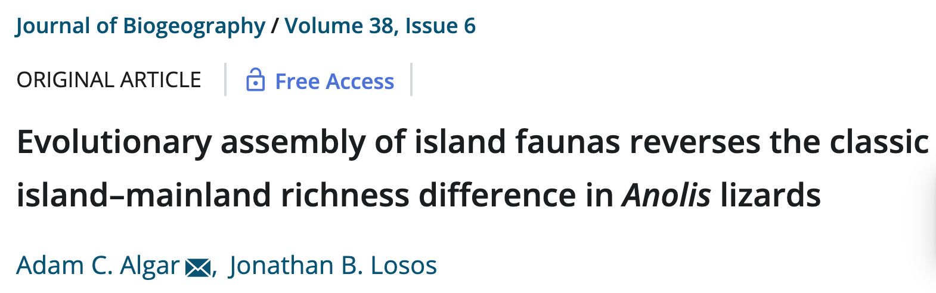
The art of the title
Imagine you do a study on anole biogeography. What is your title going to be?

Slide 19
Class activity 2:
Let’s now go on-line to the UW library, find a journal, open the table of contents, and look at it. We will use the Canadian Journal of Fisheries and Aquatic Sciences as an example.
http://catalog.lib.washington.edu/search~

Slide 20
Let’s look at the most recent issue of the journal and scan the titles. Which would you choose to read, and why? Do some words in the titles intrigue you or turn you off?
Are you looking for reference to a place such as “Alaska” or an organism such as “octopus” or a theme such as “conservation” or a discipline such as “genetics”?

Slide 21
3. The art of the title
The unspoken rules of the title:
Don’t underestimate the power that your title can have
Tailor the title to your audience, which may be dictated by the choice of journal
Too broad, and you risk disappointing people
Too narrow, and you risk selling yourself short
When in doubt, use a title that tells the main message
Many people will only read the title.
What would you want those people to know?

Slide 22
Assignments for today and Thursday:
1. Choose a single journal article that speaks to you in some way. It does not have to be on the same topic as your project. This choice is very important. You will read that article closely, write about it, tease it apart, present it to the class, and in other ways make it a focal part of your experience in this course. It will be the basis of your poster later in the course. We will continue looking in class on Thursday.
2. Write down a refined question for your research paper, including a set of hypotheses (H-null and H-alternative) for your project. I will do one-on-ones with you today about continuing to refine your project. This is due before class Thursday. Submit on canvas.

